Slide 1

Michael
RockSat-X: Hephaestus Midterm Project Update
Oregon State University
February 21st, 2017
Group 26: Helena Bales, Amber Horvath, Michael Humphrey
‹#›

Slide 2
1.0 Mission Overview
Michael

Slide 3
Mission Overview
Michael
The Oregon State University RockSat-X team will demonstrate that an autonomous robotic arm can locate predetermined targets around the payload under microgravity conditions by using precise movements.
The technical actions performed by this demonstration will illustrate a proof of concept for creating assemblies, autonomous repairs, and performing experiments in space.

Slide 4
Success Criteria:
Michael
Minimum Success Criteria:
The arm assembly body shall deploy and a video sweep is successfully recorded.
The arm assembly body shall be fully retracted after data collection.
Comprehensive Success Criteria:
The arm assembly body shall deploy and a video sweep is successfully recorded.
The arm shall make contact with predetermined targets around the payload.
The camera shall record all instances of contact between the arm and the targets.
The arm assembly body shall be fully retracted after data collection.

Slide 5
Concept of Operations
Michael
Launch: The payload will stay dormant for launch and the journey to apogee
Microgravity: After the rocket completes despin, the arm assembly body will extend out of the rocket and perform its demonstration.
After the arm assembly body is fully extended outwards, the camera will perform sweeping shot of the surrounding space.
The arm will maneuver towards the target to make contact.
Contact will be confirmed when a sensor registers an appropriate amount of force.
Previous steps will be repeated until contact has been made with each target
Descent: The arm assembly body will retract before descent begins and will stay retracted until splashdown.

Slide 6
2.0 Mission Overview
Amber

Slide 7
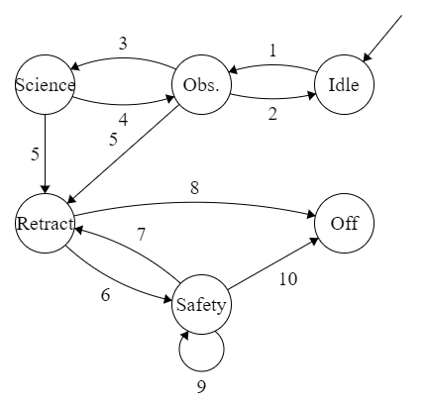
Software Design Overview - Modes of Operation
Amber
State diagram detailing the high-level transition between states
State Transition Key
Experiment begins. Payload is on, camera is powered on. Proceeds to Observation.
Camera is not on; return to Idle to recover.
Camera sweep has been performed and payload has been deployed. Arm is deployed. Proceed to Science.
Arm or payload fails to deploy or becomes stuck; return to Observation to recover.
Experiment has timed out. Proceed to Retract to
prepare for descent
Arm or payload fails to retract correctly or camera
fails to power off; proceed to Safety to recover.
Excess transition to be removed.
Arm is retracted, payload is retracted, camera is
powered off, OBC is powered off. Proceed to off
mode; Payload ready for descent.
Attempt to return arm to default position, attempt to
retract payload, and attempt to power off camera
and OBC until successful.
See 8.

Slide 8
Software Design Overview - Flow Diagram
Amber
Flowchart detailing our mode of operations during the flight

Slide 9
Software Design Details - Arm Motion
Helena Bales
The motion of the arm shall be controlled by the On Board Computer (OBC) interfacing with the motor drivers.
The path of the arm shall be generated on orbit using the A* pathfinding algorithm within an ℝ⁴ configuration space (C-Space).
Input: Path generated by A* through the C-Space
Output: Motor control commands
Pseudocode:
void function moveArm(path) {
current = first node in path
remove first node from path
for p in path {
//move from current to p
moveStep(current, p);
remove p from path
}
}
void function moveStep(current, p) {
//let current=<𝛳₁, 𝛳₂, 𝛳₃, 𝛳₄>
//let p=<𝛳₅, 𝛳₆, 𝛳₇, 𝛳₈>
delta1 = 𝛳₅ - 𝛳₁
delta2 = 𝛳₆ - 𝛳₂
delta3 = 𝛳₇ - 𝛳₃
delta4 = 𝛳₈ - 𝛳₄
move motor 1 delta1 steps
move motor 2 delta2 steps
move motor 3 delta3 steps
move motor 4 delta4 steps
}

Slide 10
Software Design Details - Configuration Space
Helena Bales
The Configuration Space is in ℝ⁴.
It represents every possible configuration of the arm’s motors.
Areas in the configuration space can be mapped to a single point in real space.
A single point in the C-Space represents a valid configuration of the payload’s motors.
C-Space in ℝ⁴
Real space in ℝ³
forward kinematics,
easy to calculate
inverse kinematics,
hard to calculate

Slide 11
Software Design Details - Creating the C-Space
Helena Bales
Every valid configuration of the payload’s motors must be mapped in the C-Space.
The most robust and accurate way of generating the C-Space is to use Inverse-Kinematics to map is mathematically. We will not use this method because of its complexity.
The simplest way to generate the C-Space is to move the arm through valid configurations and manually measure each angle. We want to avoid using this method if we can because it will be time-intensive and error prone.
The best way to generate the C-Space is to move the arm through valid configurations and use the motors to receive the theta values from the arm. We will be using this method to generate the C-Space, providing that we can receive data that is accurate from the motors.

Slide 12

Software Design Details - A*
Helena Bales
The path of the arm shall be generated on orbit using the A* pathfinding algorithm within an ℝ⁴ configuration space.
Input: Starting position <𝛳₁, 𝛳₂, 𝛳₃, 𝛳₄>, ending position <𝛳₁, 𝛳₂, 𝛳₃, 𝛳₄>, configuration space in ℝ⁴.
Output: Path from starting position to ending position with no collisions.
A* Progress Animation [1]
Pseudocode: [2]
function A*(start, goal) {
closedSet := {} //set of nodes already evaluated
openSet := {start} //set of known nodes
cameFrom := the empty map //map of previous steps
gScore := map with default value of Infinity //cost from start to current
gScore[start] := 0 //cost of going from start to start
fScore := map with default value of Infinity //cost from start to end
fScore[start] := heuristic_cost_estimate(start, goal) //start cost is heuristic

Slide 13
Software Design Details - A*
Helena Bales
Pseudocode: (continued) [2]
while openSet is not empty current := the node in openSet having the lowest fScore[] value if current = goal return reconstruct_path(cameFrom, current) openSet.Remove(current) closedSet.Add(current) for each neighbor of current if neighbor in closedSet continue // Ignore the neighbor which is already evaluated.
tentative_gScore := gScore[current] + dist_between(current, neighbor) //start to current if neighbor not in openSet // Discover a new node openSet.Add(neighbor) else if tentative_gScore >= gScore[neighbor] continue // This is not a better path
//record the new best path
cameFrom[neighbor] := current gScore[neighbor] := tentative_gScore fScore[neighbor] := gScore[neighbor] + heuristic_cost_estimate(neighbor, goal)
return failure;

Slide 14
Software Design Details - A*
Helena Bales
Pseudocode: (continued) [2]
function reconstruct_path(cameFrom, current) total_path := [current] while current in cameFrom.Keys: current := cameFrom[current] total_path.append(current) return total_path
Note: If the configuration space consists of equally-spaced nodes, then a special case of the A* algorithm can be used, Dijkstra’s algorithm. Our ability to use Dijkstra’s algorithm will depend on the method we use to create the configuration space.

Slide 15
Software Design Details - Emergency Arm Retraction
Amber Horvath
In the case of the arm getting caught in a bad state, we shall retract the arm back into a safe state
This will be accomplished by testing for a bad state
We will retract the arm and test whether or not we’re in our calibrated normal position
If we are not, we are in a bad state and need to execute the emergency arm retraction
We will then disable each motor except the one attached to the base of the payload
Once each motor has been disabled, we will retract the base of the payload

Slide 16
Software Design Details - Touch Sensor
Amber Horvath
Within the body of the payload, two touch sensors will be placed at predetermined locations
The arm shall make contact with the touch sensor and press it
Upon being pressed, the touch sensor will go high and send a signal over telemetry
The result of this touch will also be recorded locally on an SD card
The arm will then recalibrate before moving to the next sensor
If no sensors remain, the arm will retract and await shutdown

Slide 17
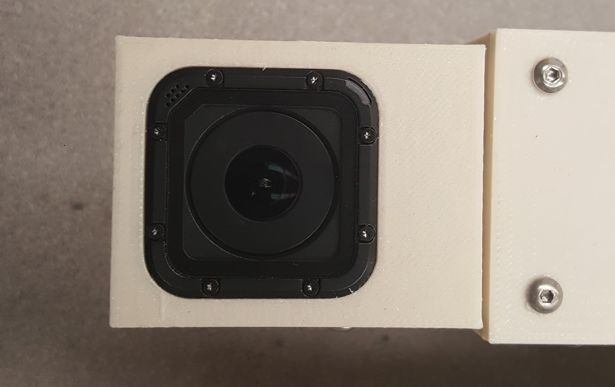
Software Design Details - Video Camera
Michael
One GoPro Hero camera will be mounted to the payload.
The camera shall be controlled by a single motor adjusting the rotation of the camera.
The camera shall record video to its own SD card.
The camera shall be powered on and off at the appropriate times by hardware triggers.
This will be handled by the Electronics team.

Slide 18
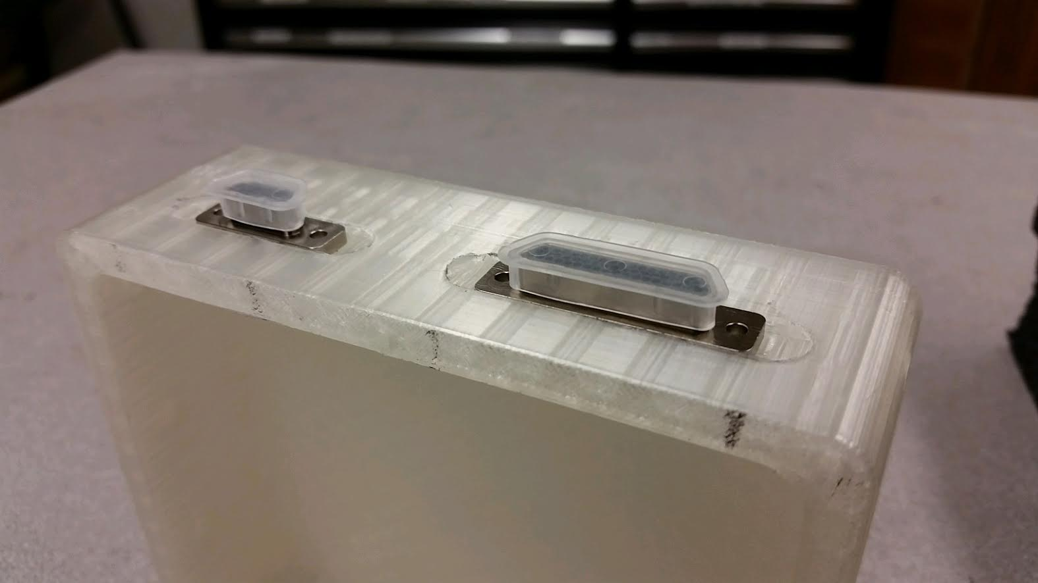
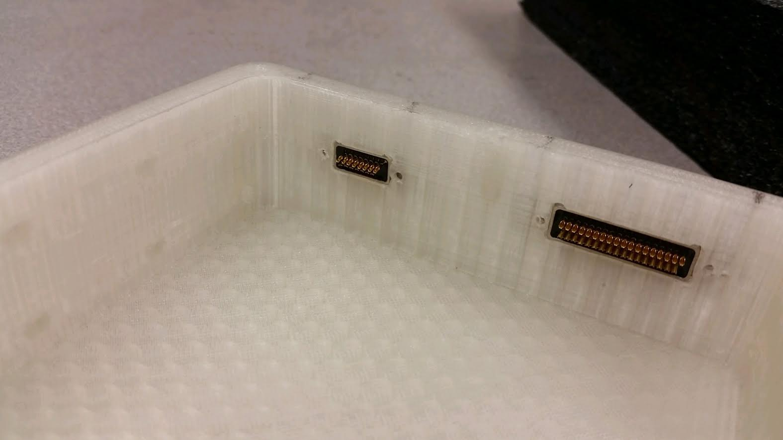
Software Design Details - Telemetry
Michael
The payload software shall report telemetry codes via 4 parallel lines.
There shall be 16 4-character codes, representing various states and checkpoints the program reaches.
Examples:
State transition
Touch sensor activated
Calibration

Slide 19
Software Design Details - Telemetry
Michael
The payload software shall save a detailed log of operations to an on-board SD card.
The log should include
Time in tenths of seconds since power on
Description of event
Any applicable telemetry codes

Slide 20
Software Design Details - Data Visualization
Michael
There shall be a stand-alone software program to read and display the telemetry data stored on the SD card.
The software shall be written in Python, because of the team’s familiarity with the language as well as its ease of use and readability.
The matplotlib Python library shall be used to generate graphs and charts of the data obtained.
The Tkinter Python library shall be used to create the Graphical User Interface (GUI)
There shall be graphs representing temperature data and a timeline of significant events.

Slide 21
3.0 Progress Update
Helena

Slide 22
Update on Configuration Space Creation
Helena
The Configuration Space has not yet been created. The process for creating the configuration space has been designed and the nature of the configuration space is known.
Blocks:
Motors were received on February 20th, unblocking this step.
Remaining Work:
The payload must be lined with foam core sheets in order to provide a buffer of invalid space before any collision occurs.
Motors must be installed on the payload by the electrical team.
Arm must be moved through all valid configurations.
Thetas corresponding to valid configurations must be collected from the motors by converting from steps to degrees.
Valid configurations must be stored for later use on orbit.

Slide 23
Update on Pathfinding
Helena
The pseudocode for the pathfinding algorithm has been written. The code for pathfinding has not yet been written.
Blocks:
The configuration space must be created before implementing the code. This is a block because if the C-Space nodes are uniformly spaced, A* can be replaced with Dijkstra’s algorithm.
Remaining Work:
A* or Dijstra’s algorithm must be implemented on the OBC.

Slide 24
Update on Arm Movement
Helena
The motor control drivers have been written by the EE team. The pseudocode for executing a given path has been written.
Blocks:
The motors were received on February 20th, unblocking this step.
Remaining Work:
The format for the path must be finalized.
The code must be implemented on the OBC.

Slide 25
Update on Emergency Payload Retraction
Amber Horvath
The motor control drivers have been written by the EE team. The pseudocode for retracting the arm has been written.
Blocks:
Did not have access to motors, preventing any sort of implementation or testing to occur
The motors were received on February 20th, unblocking this step.
Remaining Work:
The code must be implemented on the OBC.
The motors must be attached to the arm body.

Slide 26
Update on Touch Sensors
Amber Horvath
We have received the touch sensors. We have not yet chosen where to place them within the payload.
Blocks:
Do not have arm able to move yet since we only just got the motors and have not implemented the code to actually move the arm to a location so we can not test making the arm touch a sensor yet.
Remaining Work:
The code must be implemented on the OBC.
The motors must be attached to the arm body.
The touch sensors must be placed within the payload.

Slide 27
Update on Video Camera
Michael
The GoPro Hero camera has been purchased and received. The Electronics team has disassembled the camera, and found ways to trigger video capture autonomously.
Blocks:
None
Remaining Work:
Subsystem testing of video recording, storage, and playback.

Slide 28
Update on Telemetry
Michael
Half of the telemetry codes have been allocated. The remaining eight telemetry codes are left to be determined on an as-needed basis.
Blocks:
None.
Remaining Work:
Creating an API for parallel line telemetry and SD card log.
Implement interface.

Slide 29
Update on Data Visualization
Michael
No progress has been made. This subsystem may be completed after the payload has been completed.
Blocks:
Lack of data to test with.
Remaining Work:
Reading the data from the SD card.
Processing the data.
Displaying the data.

Slide 30
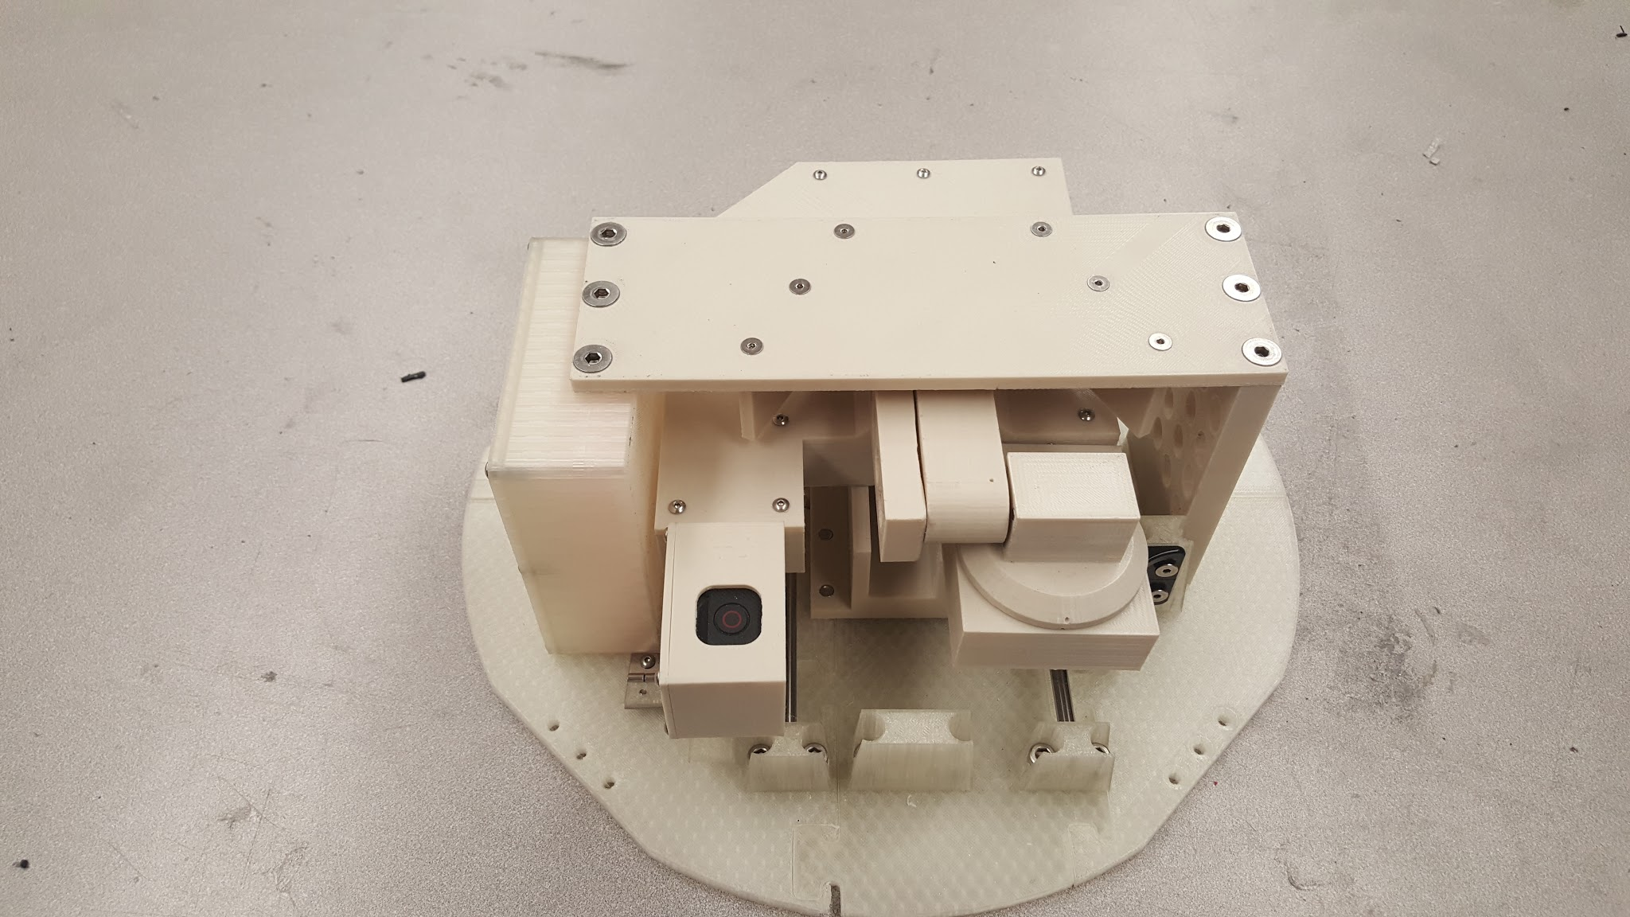
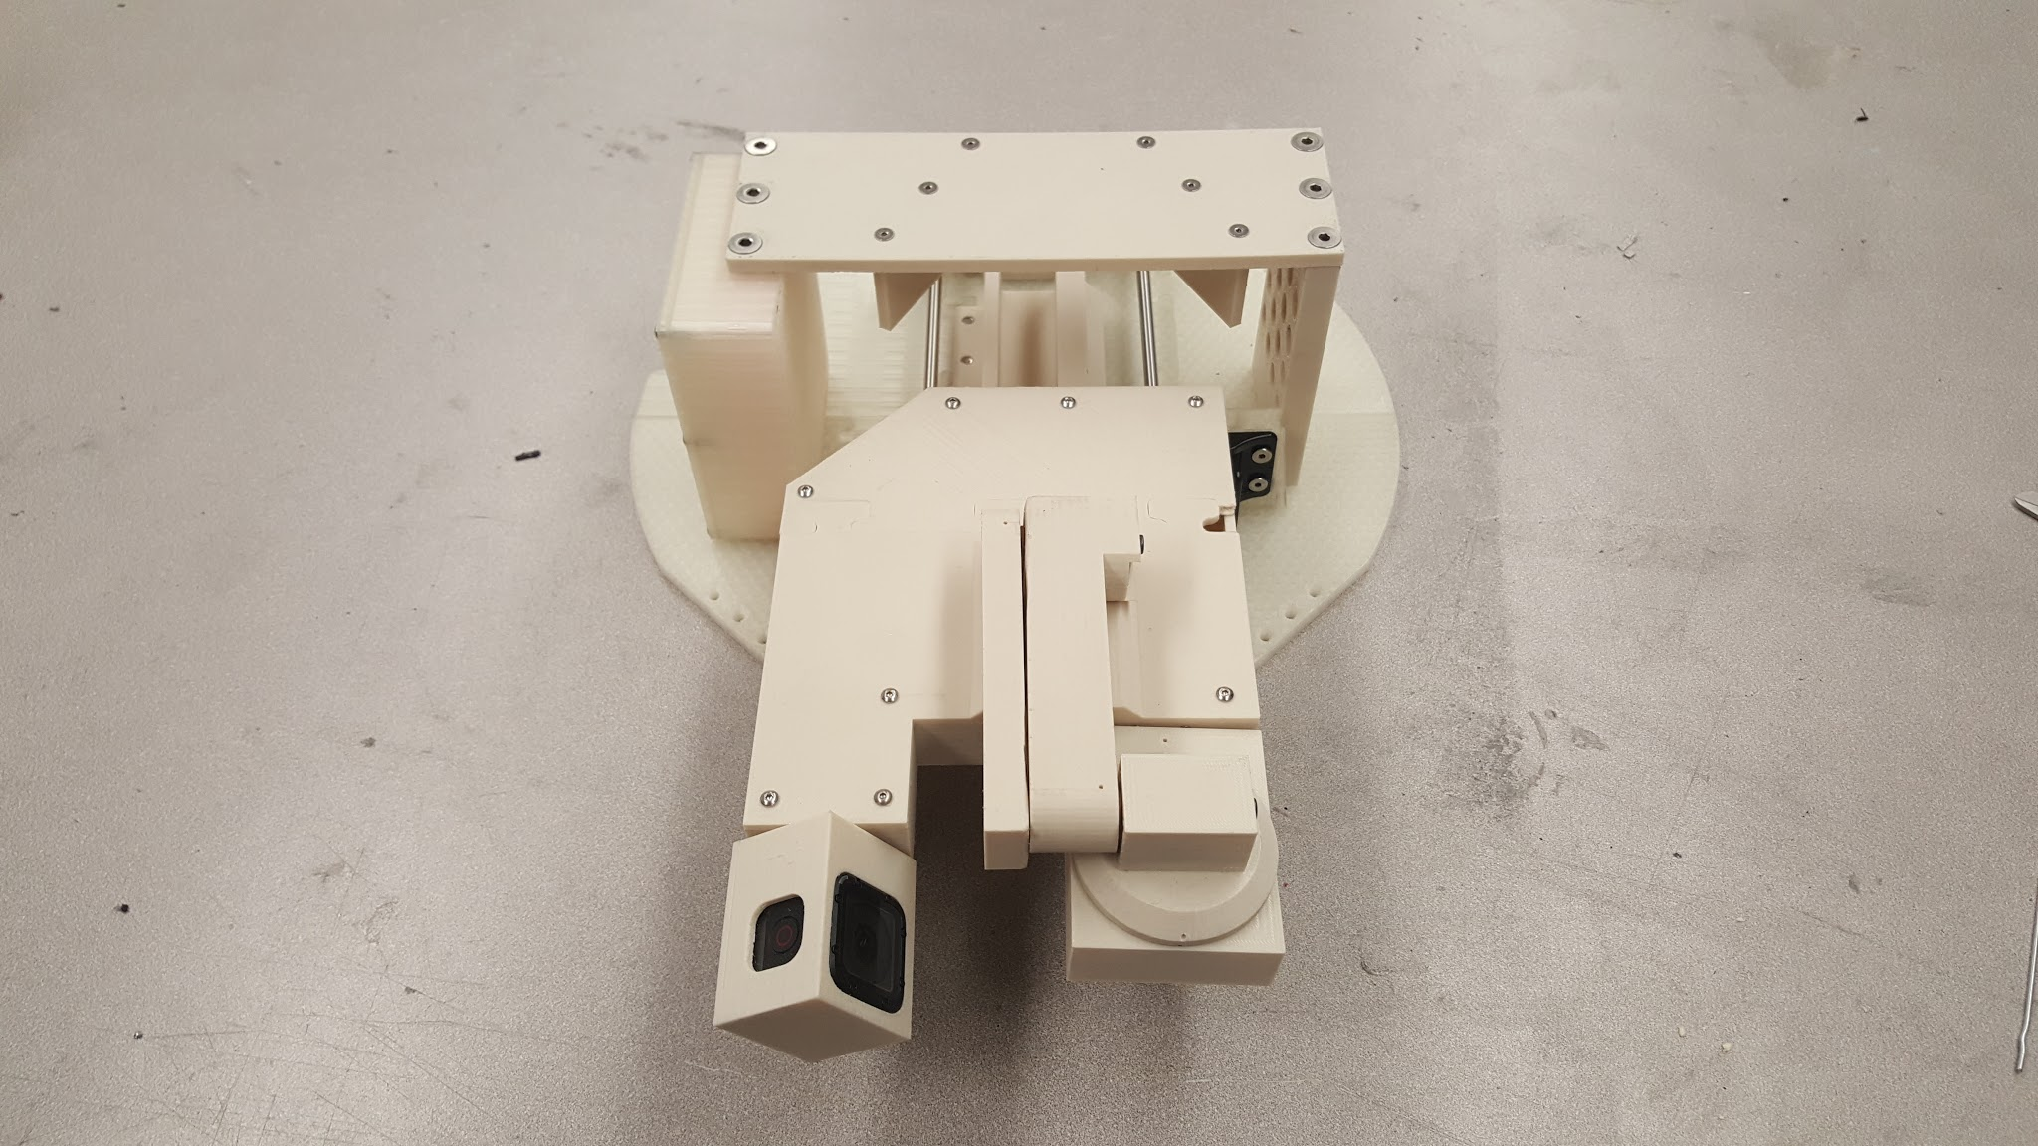
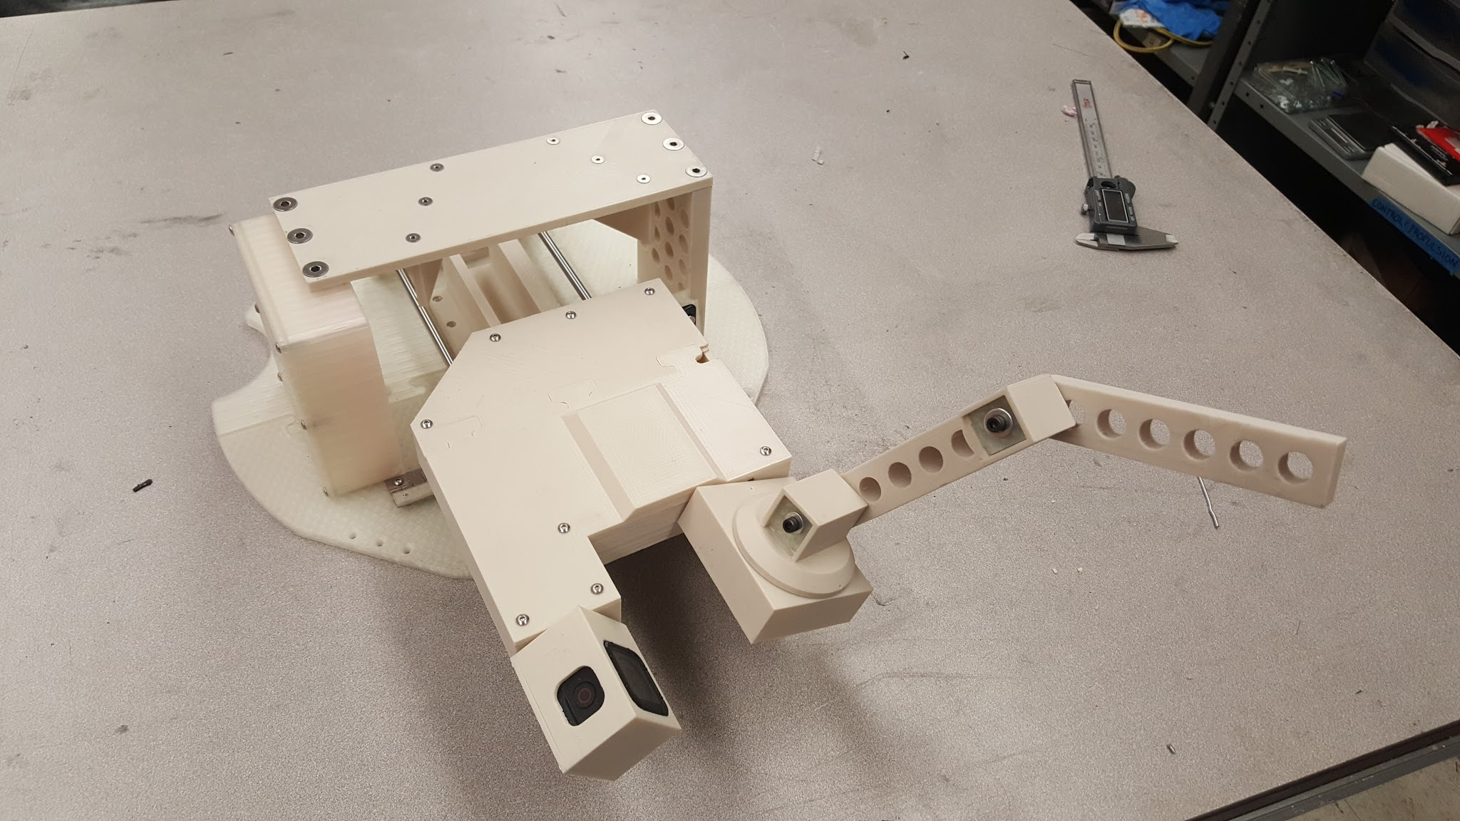
Update from Mechanical Team
Amber Horvath
Quick Status
Current Progress is slowed by a funding delay. Motor order pushed back approximately 3 weeks and 5 of the 6 testing motors are set to ship 2/16/17.
3D Model Completion has allowed preliminary testing to begin and move forward in absence of motors.

Slide 31
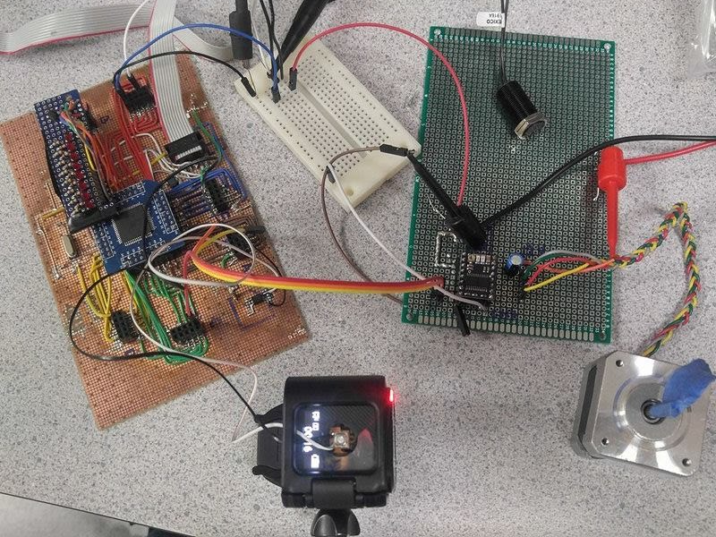
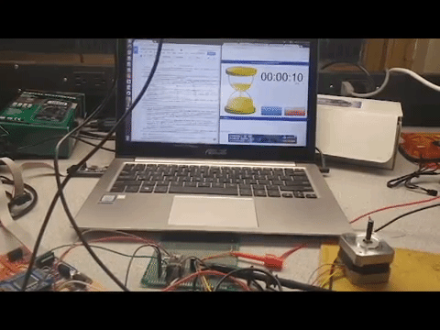
Update from Electrical Team
Amber Horvath
Quick Update:
ATmega128 can be programmed.
Motor control drivers have been programmed.
Voltage regulator has been completed then redesigned.

Slide 32
4.0 Project Hurdles

Slide 33
Blockers
Amber Horvath
Funding delayed
Working prototype not yet complete
Notes:
Our funding release was delayed, so we were unable to purchase supplies until later in the term. This lead to us not getting our motors until February 20th. Due to this delay, we have been unable to test the implementation of our drivers.
Due to the nature of our project, it is difficult to implement and test code without a working prototype of the arm.

Slide 34
5.0 Programmatics
Amber

Slide 35
Budget
Amber
Budget Summary - 2/16/17
Sections | Budgeted | Spent | Remaining
Motors | $5,050.00 | $1,312.50 | $3,737.50
Aluminum Stock | $527.12 | $480.60 | $46.52
Camera | $1,199.94 | $599.97 | $599.97
Purchased Components | $557.18 | $702.71 | -$145.53
PCB | $250.00 | $0.00 | $250.00
Manufacturing | $500.00 | $0.00 | $500.00
Electrical Components | $373.05 | $0.00 | $373.05
Connectors | $180.00 | $242.60 | -$62.60
Microcontrollers | $55.00 | $0.00 | $55.00
Sensors | $301.00 | $117.29 | $183.71
Project Total | $8,993.29 | $3,455.67 | $5,537.62
Lodging | $6,000.00 | $0.00 | $6,000.00
Deposit | $14,000.00 | $2,000.00 | $12,000.00
Total | $28,993.29 | $5,455.67 | $23,537.62

Slide 36
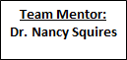
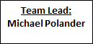
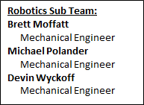
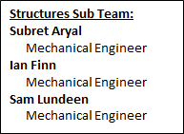
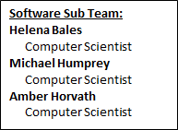
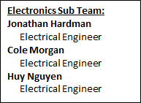
Organization Chart
Michael

Slide 37
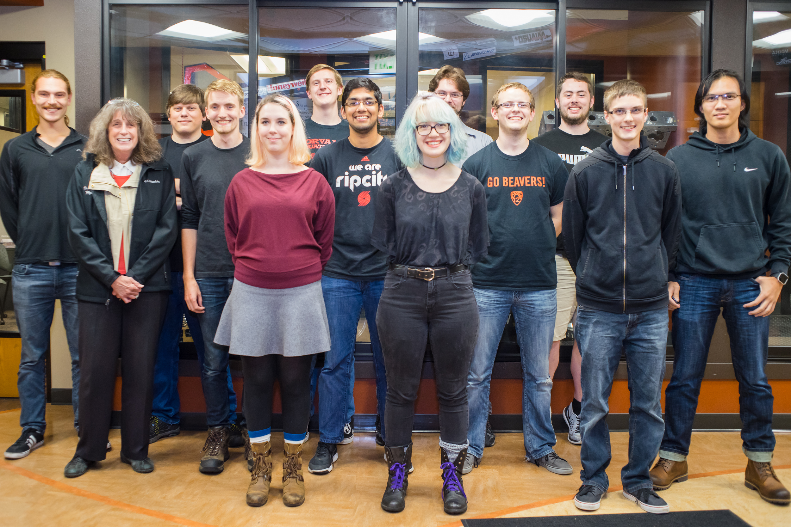
Team Picture
Michael
Left to Right:
Ian Finn
Nancy Squires
Jon Hardman
Cole Morgan
Helena Bales
Sam Lundeen
Subret Aryal
Amber Horvath
Mike Polander
Brett Moffatt
Devin Wyckoff
Mike Humphrey
Huy Nguyen

Slide 38
Citations
[1] S. Bhattacharya, A Star Progress Animation. 2011.
[2] "A* search algorithm", En.wikipedia.org, 2017. [Online]. Available: https://en.wikipedia.org/wiki/A*_search_algorithm#Pseudocode. [Accessed: 21- Feb- 2017].

